Slide 1

Getting Connected to caBIG® and the Grid: caGrid Overview
caBIG 2009 Annual Meeting
Washington, D.C.
July 20th – 22nd, 2009

Slide 2
Agenda
caBIG Context
caGrid High Level Overview
caGrid Core Service/Component Survey
caGrid Workflow
caGrid Portal

Slide 3

What is caBIG?
Common, widely distributed infrastructure that permits the cancer research community to focus on innovation
Shared, harmonized set of terminology, data elements, and data models that facilitate information exchange
Collection of interoperable applications developed to common standards
Cancer research data available for mining and integration

Slide 4

What is caGrid?
A grid based software infrastructure consisting of services, toolkits, APIs, and applications
A production grid deployment of the core services provided by that infrastructure
A community of developers leveraging that grid and infrastructure to provide applications and services to the cancer research community

Slide 5

What is caGrid to caBIG?
The “G” in caBIG
Cancer Biomedical Informatics Grid
Provides the software foundation which underlies the tools and applications of caBIG
Analogous to the “power grid”
A multitude of applications with differing requirements can seamlessly be plugged in to a common infrastructure

Slide 6
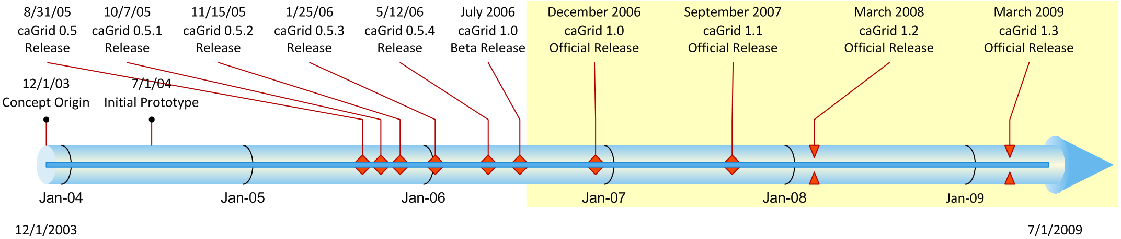
History of caGrid
Developed as the Grid toolkit for caBIG, 2004
caGrid 1.0 was a revolutionary release of the caGrid infrastructure (yellow highlight), replacing the 0.5.x test bed stream
The last release of caGrid was version 1.3, released mid March 2009
Notes:
6

Slide 7
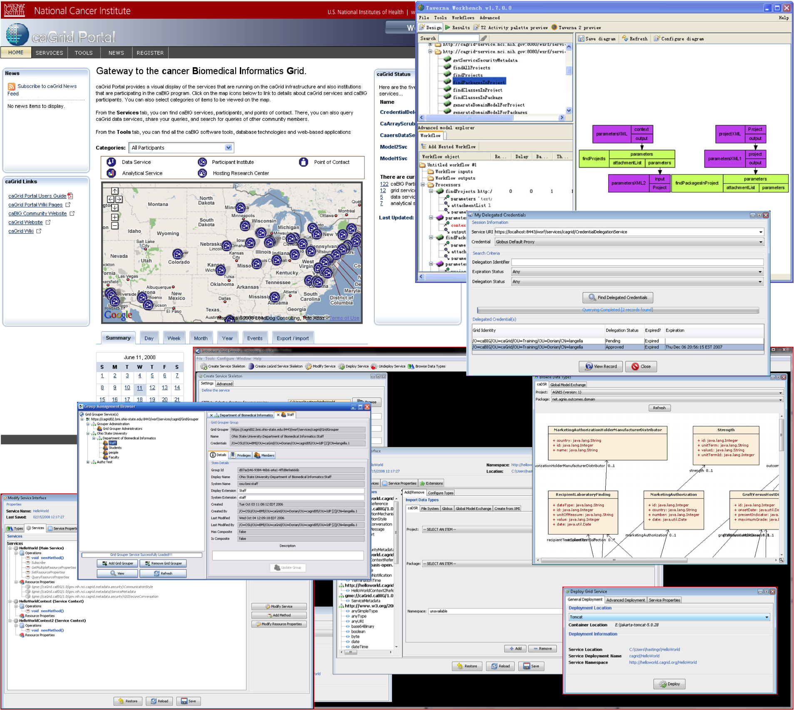
The caGrid Suite
Currently consists of three high-level products:
caGrid Core Infrastructure
consisting of the core services, APIs, and tools
caGrid Workflow Client
focusing on making workflows usable by the scientific community
caGrid Portal
providing a web-based application enabling discovery and interaction with the services that are available on the caGrid infrastructure

Slide 8
A Software Infrastructure: Focus Areas
Leveraging Grid technologies and standards as an interoperability platform
Metadata Infrastructure
Surfacing wealth of existing caBIG data-oriented metadata on the grid
Providing new service-oriented metadata
Security
Integrating existing systems and applications with Grid security
Lowering burden of implementation of grid-wide and local policy
Service Developer Tooling
Powerful platform for bringing applications and data to the grid
Facilitating Grid wide operations
Federated query, workflow execution, resource discovery
Making the Grid more accessible
Graphical installation and configuration, higher-level object-oriented APIs, web portals, graphical administrative applications
Quality
Comprehensive testing infrastructure, automated builds and test execution on multiple platforms, dashboard with historical archive

Slide 9
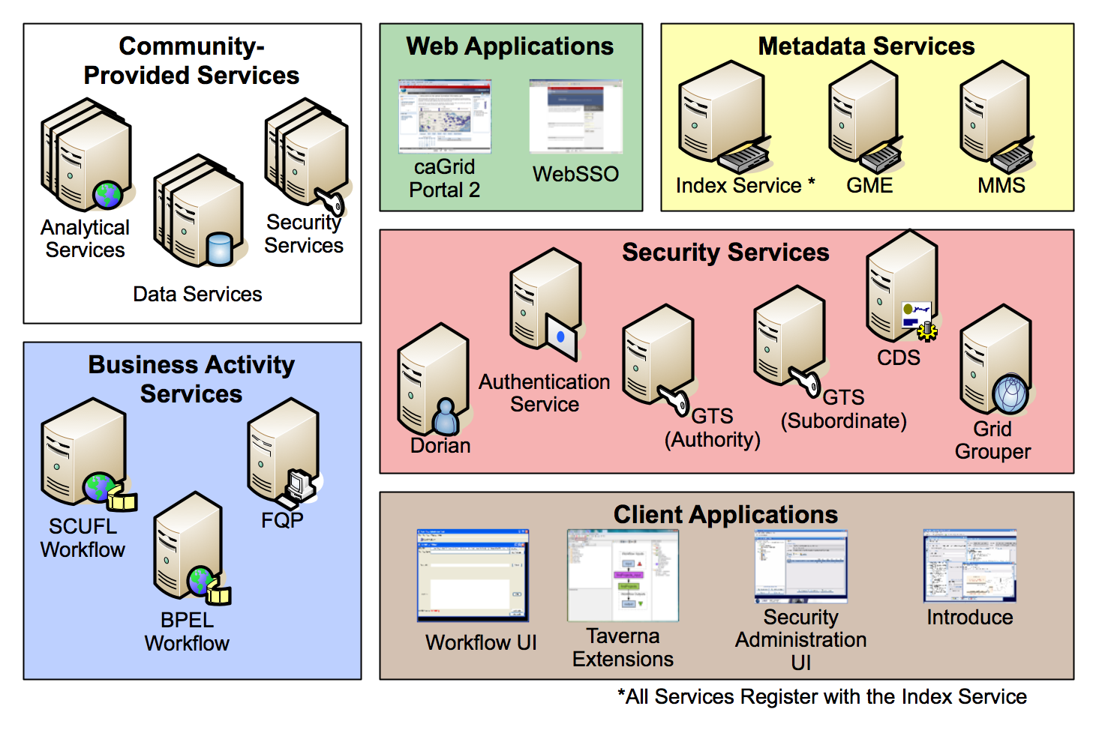
A Production Grid Deployment: caGrid Core Services

Slide 10
A Community of Developers: Community Involvement
caGrid itself provides no real “data” or “analysis” to caBIG™; its the enabling infrastructure which allows the community to do so
Community members add value to the grid as applications, services, and processes (for example: shared workflows)
caGrid provides the necessary core services, APIs, and tooling
The real “value” of the grid comes from bringing this information to the “end user”
Community members develop end user applications which consume of the resources provided by the grid

Slide 11
caGrid 1.3 Core Services
All caGrid Core Services were redeployed on all caBIG® Grids
(OSU Training, QA, Stage, and Production) for this release.
The (12) caGrid 1.3 Core Services are:
* New for 1.3 ** Significantly Rewritten or Enhanced for 1.3
Metadata Services | Security Services | Business Activity Services
Global Model Exchange Service** | Authentication Service** | Federated Query Processor Service**
Index Service** | Credential Delegation Service | BPEL Workflow Service
Metadata Model Service* | Dorian Service** | Taverna Workflow Service*
 | Grid Grouper Service
 | Grid Trust Service (Master & Slave)

Slide 12
Metadata Services
Metadata Model Service (MMS)
MMS is a general purpose service which acts as an adapter between existing metadata registries and caGrid
The MMS grid service provides:
Semantic Annotation of service metadata, referencing external registries
Data Service metadata generation capabilities, referencing external registries
Global Model Exchange (GME)
GME is data definition registry and exchange service that is responsible for storing and linking together data models in the form of XML schema.
The GME grid service provides:
Access to the authoritative structural representation of data types on the grid
Globus Information Services: Index Service
The Globus Information Services infrastructure provides a generic framework for aggregation of service metadata, a registry of running Grid services, and a dynamic data-generating and indexing node, suitable for use in a hierarchy or federation of services
The Index grid service provides:
Yellow and white pages for the grid

Slide 13
caGrid Data Description Infrastructure
Client and service APIs are object oriented, and operate over well-defined and curated data types
Objects are defined in UML and converted into ISO/IEC 11179 Administered Components, which are in turn registered in the Cancer Data Standards Repository (caDSR)
Object definitions draw from controlled terminology and vocabulary registered in the Enterprise Vocabulary Services (EVS), and their relationships are thus semantically described
XML serialization of objects adhere to XML schemas registered in the Global Model Exchange (GME)

Slide 14
caGrid Standard Service Metadata
All caGrid Services are expected to publish a set of standard metadata which draws heavily from the metadata registered in caDSR and EVS
Common Metadata describes generic information about service providing Cancer Center, points of contact, etc
The Service’s operations are defined and their inputs and outputs link to Classes in caDSR and semantics from EVS
Data Services additionally describe the domain Model they are exposing
Associations between classes
Semantics of the model itself

Slide 15
caGrid Advertisement and Discovery
All services register their service address and metadata information to an Index Service
The Index Service subscribes to the standardized metadata and aggregates its contents
Clients can discover services using a discovery API which facilitates query and inspection of metadata
Leveraging semantic information in EVS (from which service metadata is drawn), services can be discovered by the semantics of their data types

Slide 16
Data Service Overview
caGrid Data Services provide capability to expose data resources to the Grid
Specialization of caGrid grid services to expose data through a common query interface
Meet all base service requirements of caGrid services
Present an object view of data sources
Exposed objects are registered in caDSR and their XML representation in GME
Data Service Metadata describes information model
Queries made with CQL Query objects
Results returned as objects nested in a CQL Query Result Set
Graphical Development tool, implemented as an extension to the Introduce Toolkit, is used to create the new grid service

Slide 17
Data Service Query Language
Simple, “minimum entry” for data providers
Specifies a target object (result) type and selects the instances which satisfy the specified properties and nested object properties
Allows path navigation
Provides logical grouping
Provides name/predicate/value filtering on properties of objects
Recursively defined
Ability to return full Objects, Set of attributes, count of results, or distinct attribute values

Slide 18
Federated Query Processor
Provides a mechanism to perform basic distributed aggregations and joins of queries over multiple data services
As caGrid data services all use a uniform query language, CQL, the Federated Query Infrastructure can be used to express queries over any combination of caGrid data services
Federated queries are expressed with a query language, DCQL, which is an extension to CQL to express such concepts as joins, aggregations, and target services
Implemented as a stateful grid service, queries may be executed asynchronously and results retrieved at a later time
Supports secure deployments wherein result ownership is enforced, and queries can be executed with authorization rights of the client (via delegation)
Coupled with semantic discovery capabilities of caGrid, provides a powerful framework for data discovery, mining, and integration

Slide 19
Workflow Services
Provide capability to describe “orchestrations” of service invocations and data movement
Support for existing defacto standard language: Business Process Execution Language (BPEL)
Interoperability with other clients, editors, engines
Support for community favorite tool: Taverna (SCUFL language)
User friendly editor
Implemented as stateful grid services, workflows can be created, stopped, paused, resumed, and cancelled and results retrieved at a later time
Coupled with semantic discovery, service metadata, and registration of data type structures in caGrid, provides a powerful framework for analyzing data
Services can be dynamically discovered and federated queries can be invoked as part of a workflow

Slide 20

Introduce Vision
Become the one stop shop for grid service development
Provide a simple, yet powerful, graphical user interface (GUI) to encapsulate complexities of grid service development
Provide an extensible toolkit with which grid services can be created and modified programmatically

Slide 21
Introduce Overview
A framework which enables fast and easy creation of Globus based grid services
Provide easy to use graphical service authoring tool.
Hide all “grid-ness” from the developer
Utilize best practice layered grid service architecture
Integration with other core grid services and architecture components
GAARDS Security Infrastructure
Globus Index Service
Global Model Exchange
Metadata Model Service
Cancer Data Standards Repository
Extension Framework for integrating with other architecture components

Slide 22
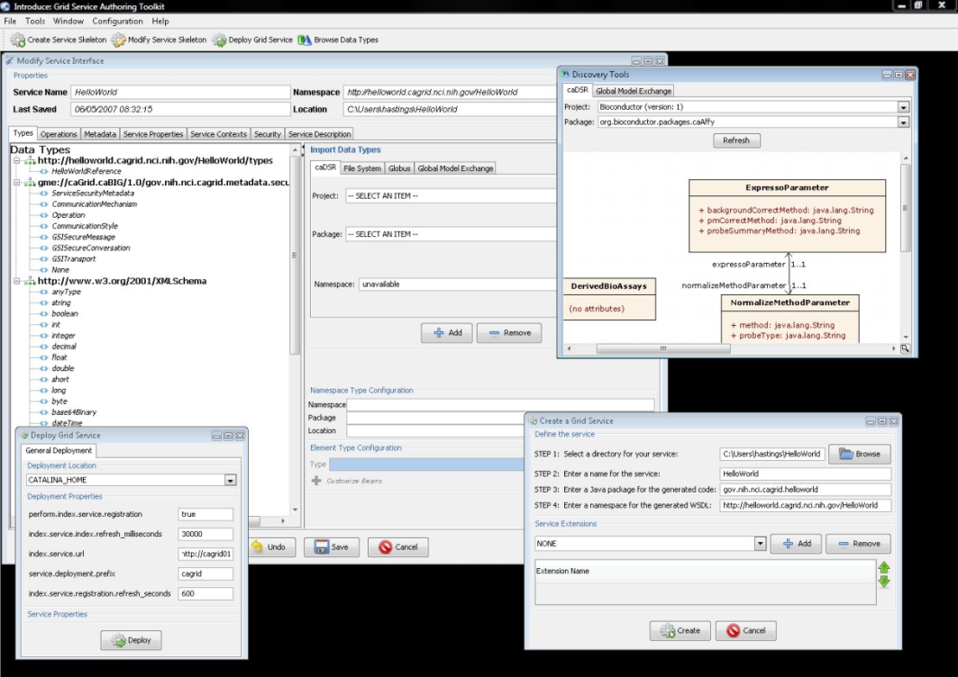
Introduce Features
Supports modification of operations
Adding operations
Removing Operations
Updating Operations
Importing Operations
Graphical Configuration
Advertisement
Security
Service Metadata Specification
Service Metadata Editing
Service Configuration Properties
Auto Generates Code for Service
Auto generates a client API for service.
Graphical Deployment of Service
Globus
Tomcat
JBoss

Slide 23




An example service development process (0 lines of developer code)
Create Semantically Harmonized Data Model
Generate
Data Resource
Grid-ify

Slide 24
GAARDS Overview
Grid Authentication and Authorization with Reliably Distributed Services (GAARDS)
GAARDS provides services and tools for the administration and enforcement of security policy in an enterprise Grid.
Developed on top of the Globus Toolkit
Extends the Grid Security Infrastructure (GSI)
Provide enterprise services and administrative tools for:
Grid User Management
Identity Federation
Trust management
Group/VO management
Access Control Policy management and enforcement
Integration between existing security domains and the grid security domain
Delegation
Web Application integration

Slide 25
GAARDS Components
Dorian
Grid User and Host Account Management
Integration point between external security domains and the grid
Allows accounts managed in external domains to be federated and managed in the grid
Dorian allows users to use their existing credentials (external to the grid) to authenticate to the grid
Grid Trust Service (GTS)
Creation and Management of a federated trust fabric
Supports applications and services in deciding whether or not signers of digital credentials/user attributes can be trusted
Supports the provisioning of trusted certificate authorities and corresponding CRLS
Grid Grouper
Group management service for the grid
Provides a group-based authorization solution for the Grid
Enforce authorization policy based on membership to groups

Slide 26
GAARDS Components cont.
Authentication Service
Integrates existing credentials providers into the grid
Provides a uniform grid interface for authenticating to existing credential providers
Applications can communicate with any credential provider
Credential Delegation Service (CDS)
Enables users/services (delegator) to delegate their Grid credentials to other users/services (delegatee) such that the delegatee(s) may act on the delegator's behalf
Extendible delegation policies
Auditing support
Web Single Sign-On (WebSSO)
Provide “Single Sign-On” capabilities for web applications which interact with the grid
Leverage grid credentials for authentication
Allows web applications to invoke grid services on the user’s behalf

Slide 27
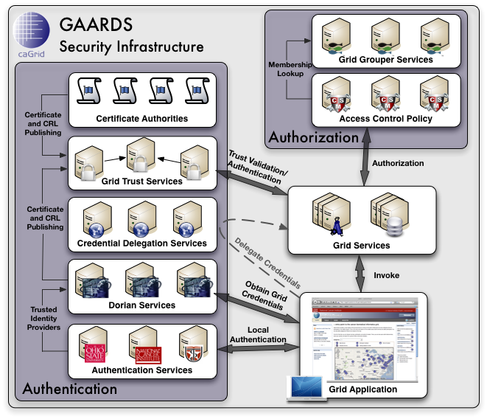
GAARDS Components cont.
Common Security Module (CSM)
Provides a centralize approach to managing and enforcing access control policy authorization
Security Metadata
Ensures communication interoperability between grid services

Slide 28












caGrid Workflow System: Components
Data-flow modeling flavor
caGrid activity
State management (WSRF)
Security (GSI)
Service discovery based on cancer research metadata.
Discovery
composition
Implicit iteration: handle parallel execution
WSRF and GSI enforcement
Workflow Exe. Service
Workflow Sub. In Portal
Community
reuse
Execution
Reuse
generate
A community to share workflow
caGrid

Slide 29
caGrid Workflow System: Lymphoma Prediction Workflow
*
Scientific value
Use gene-expression patterns associated with DLBCL and FL to predict the lymphoma type of an unknown sample.
Use GenePattern services SVM and KNN to predicting the tumor types of unknown examples.
Major steps
Querying training data from experiments stored in caArray.
Preprocessing, or normalize the microarray data.
Predicting lymphoma type using SVM & KNN services.
Extension
Generalized the lymphoma prediction workflow into a cancer type prediction workflow.
Applied it on Experiment 236 in caArray database.
*Fig. from MA Shipp. Diffuse large B-cell lymphoma outcome prediction by gene-expression profiling and supervised machine learning. Nature Medicine, 2002

Slide 30
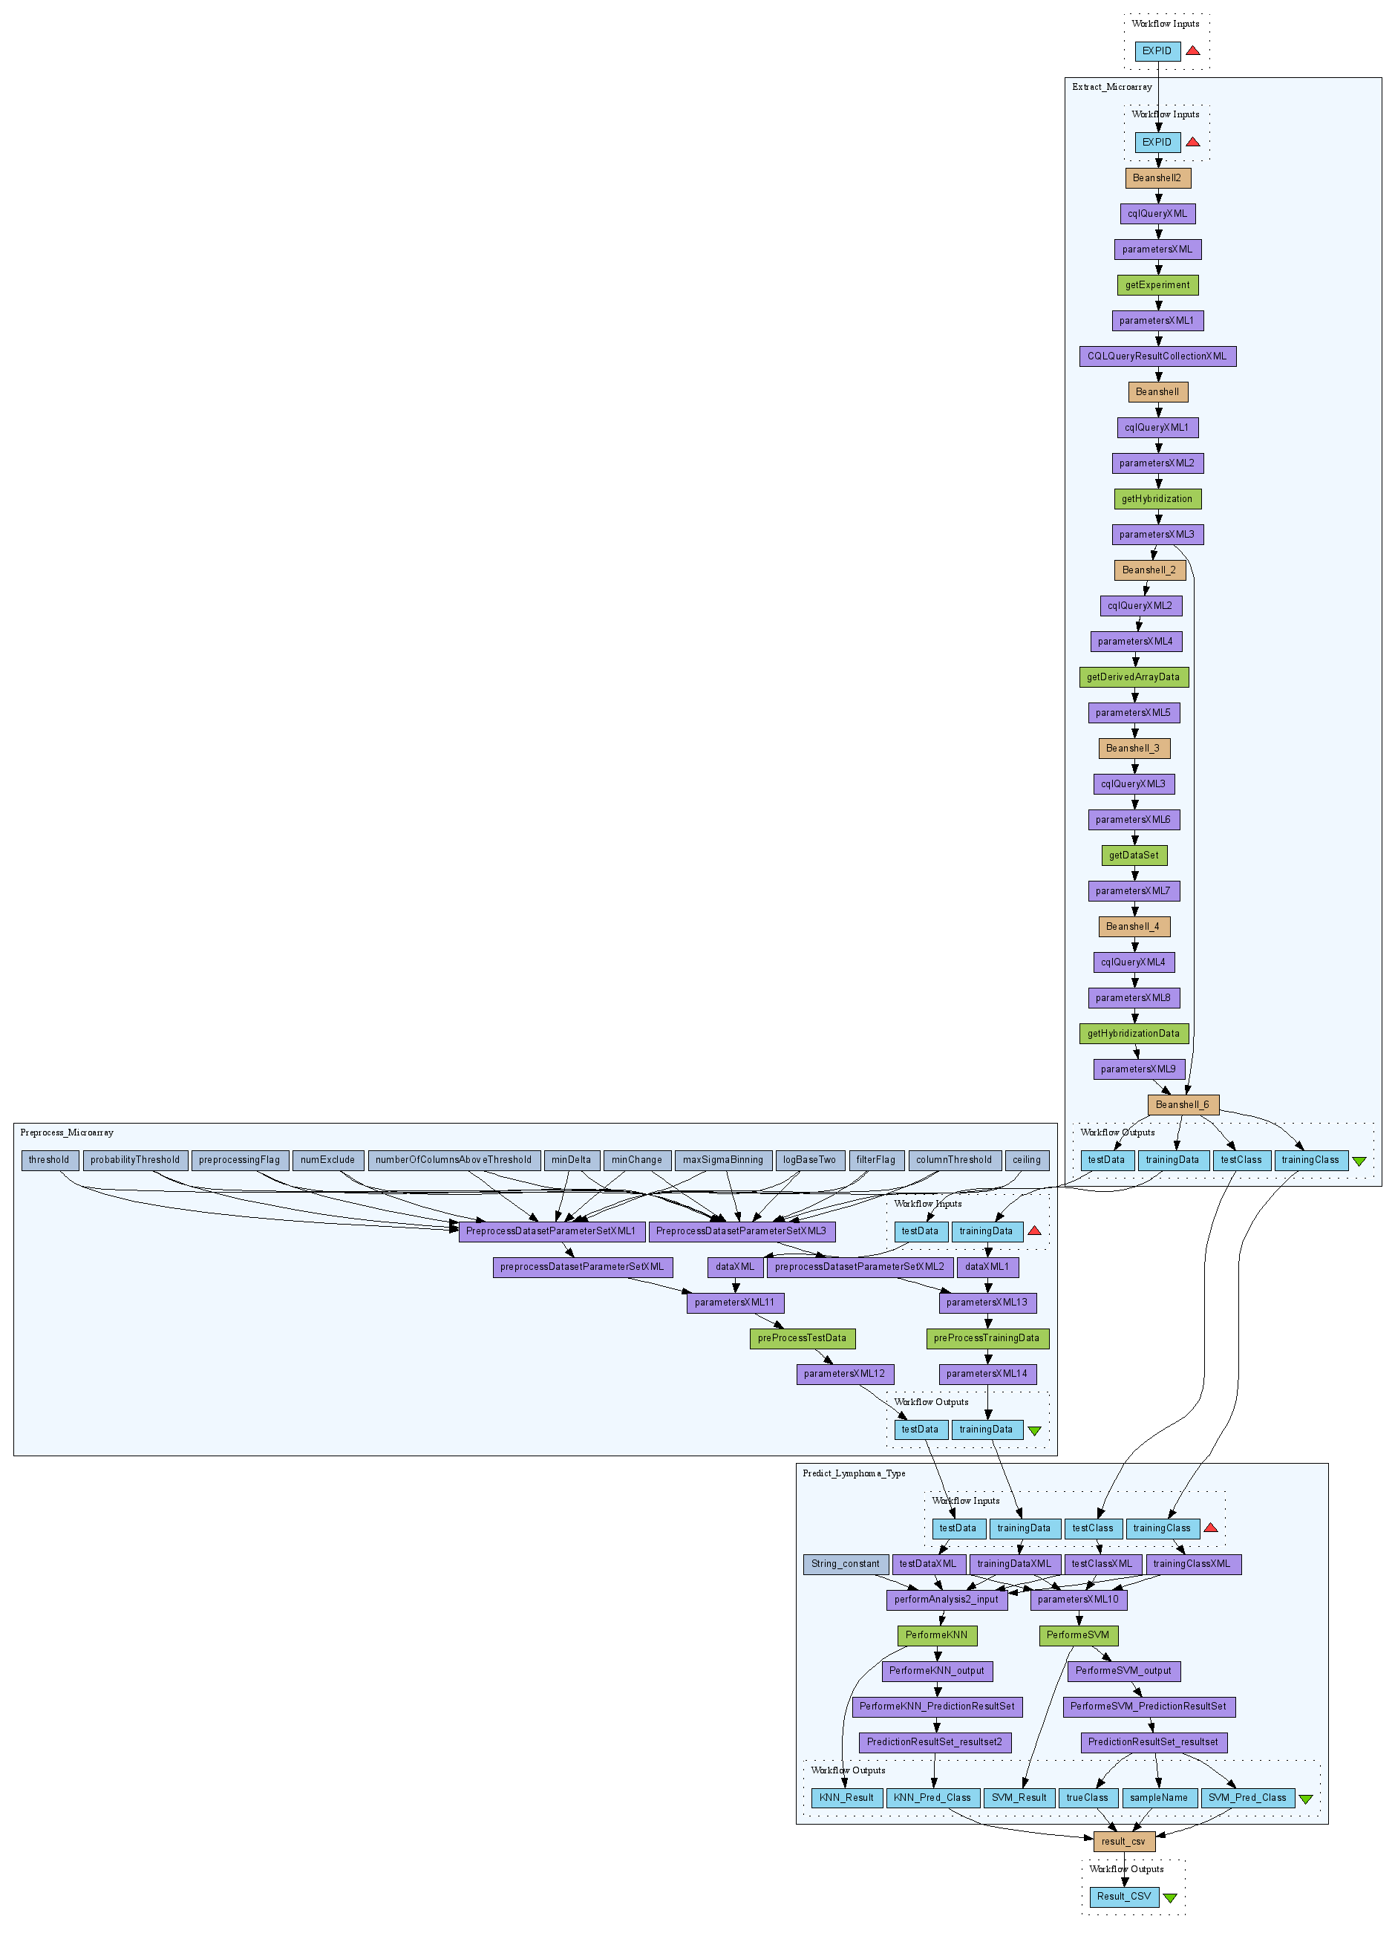
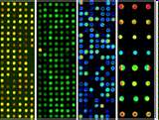
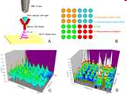
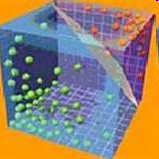
caGrid Workflow System: Lymphoma Prediction Workflow
Tumor tissue
Microarray
preProcessing
Lymphoma
prediction

Slide 31
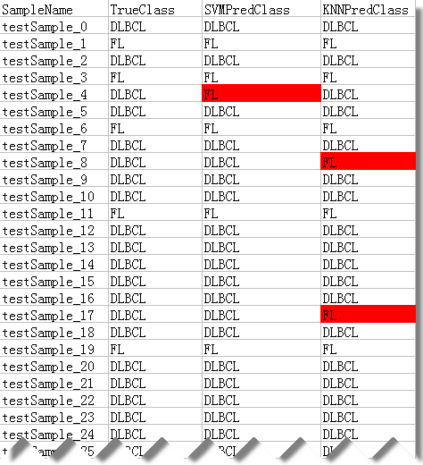
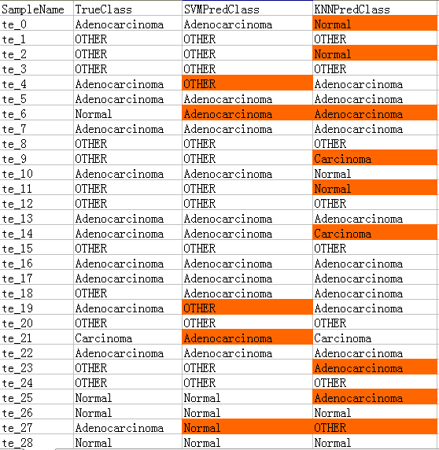
caGrid Workflow System: Lymphoma Prediction Workflow
Acknowledgement:
Juli Klemm, Xiaopeng Bian, Rashmi Srinivasa (NCI)
Jared Nedzel (MIT)

Slide 32
caGrid Workflow System: Future Work
Integration of caGrid Portal and the Workflow services
Users can discover, execute workflows from within the Portal
Integration of Grid Security with Workflow services
Including invoking Secure services, Credential Delegation and Single Sign on
Semantic Search ability for services
Ability to invoke services that use Resource Pattern

Slide 33
caGrid Portal
What is it?
caGrid Portal provides Web access to caBIG resources and information using the caGrid infrastructure.
How is it used (currently)?
Querying data sources; viewing grid service metadata and status; diagnosing deployment issues; hosting community portlets (e.g. caBIO Portlet)

Slide 34
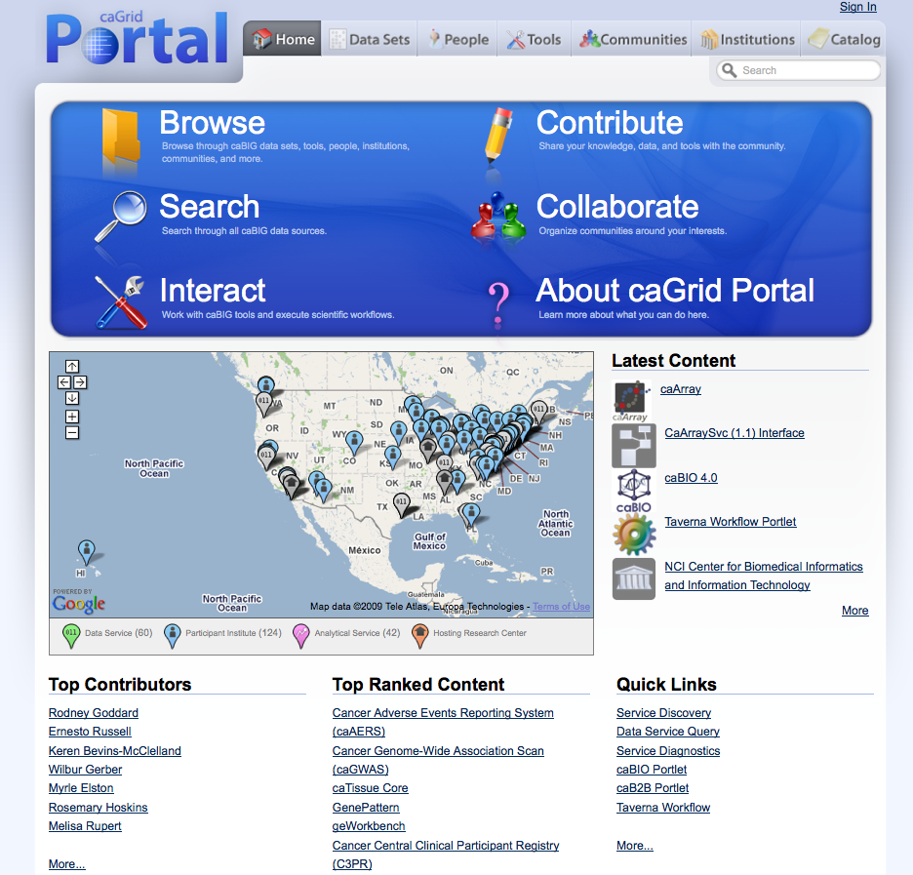
caGrid Portal - What’s new? It’s easier to use, researcher-focused
Easier to Use
Reorganizing
Content
Community Portlets
User-Contributed
Knowledge
Notes:
The site is being reorganized to make it easier to use and focus on the needs of researchers and clinicians.
Users can more easily Browse through information about data sets, tools, people, communities, and institutions that are involved with caBIG. The new Catalog feature allows users Contribute there knowledge about caBIG resources by creating new entries in the catalog or providing comments and ratings on existing entries. Searching live data sources is easier due to the enhanced query sharing feature. Researchers can Collaborate by setting up customized spaces within the portal that are provisioned with common collaboration tools (e.g. Wiki, Forum, Document Library). And it’s easier to Interact with web-based caBIG tools and execute scientific workflows using the new Taverna Workflow Portlet.

Slide 35
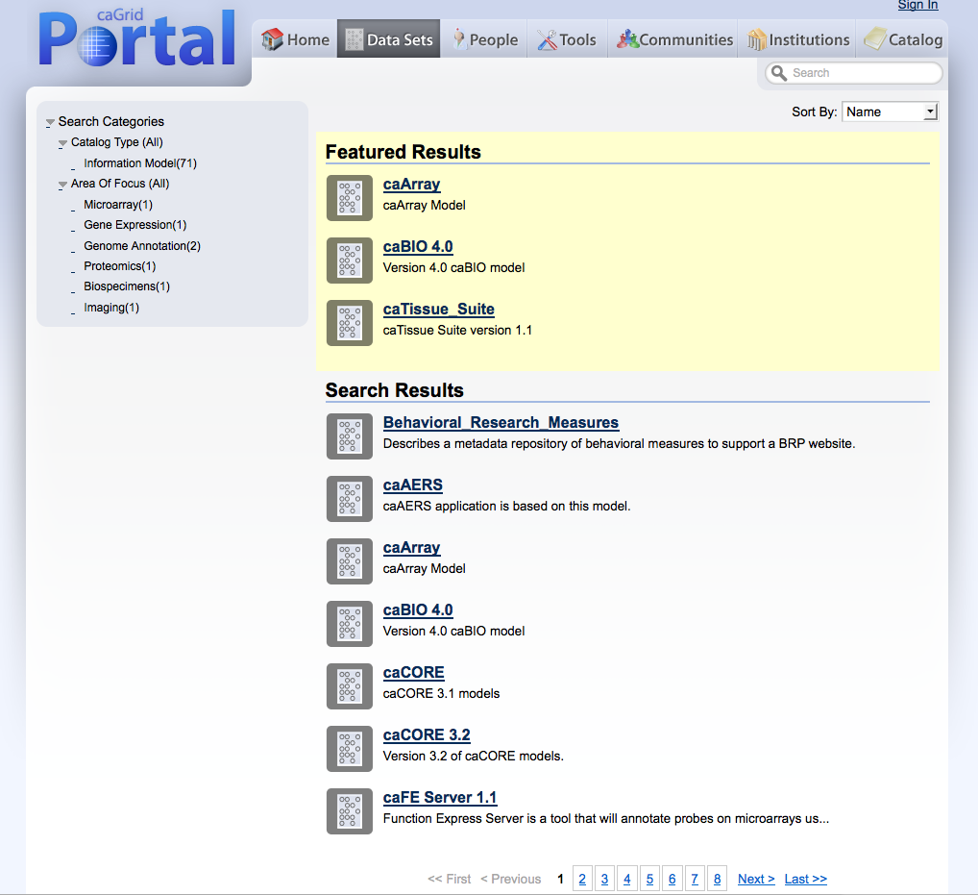
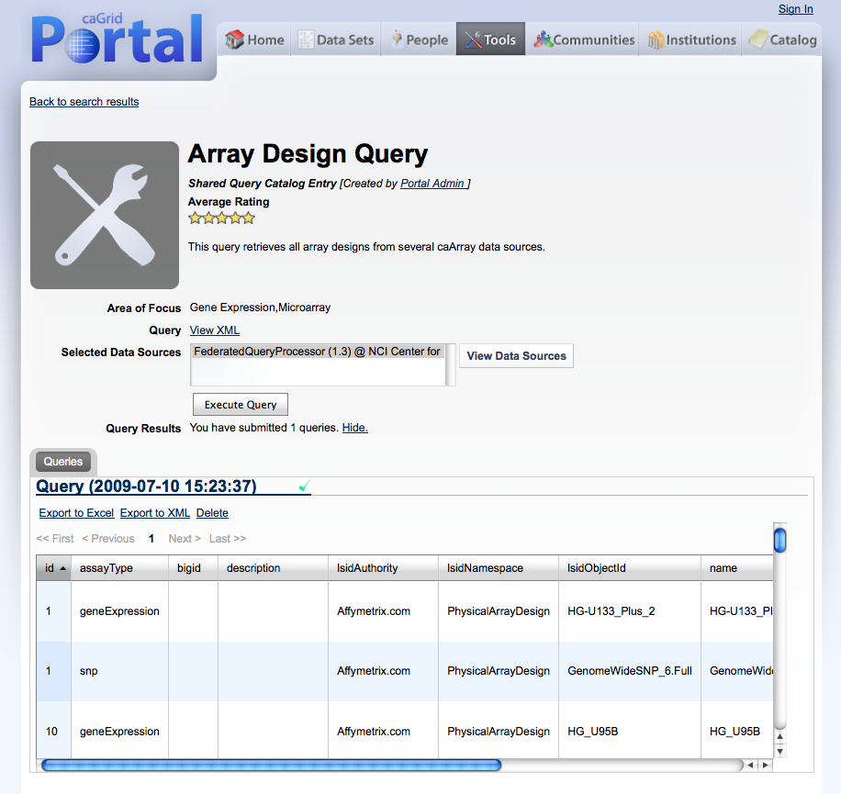
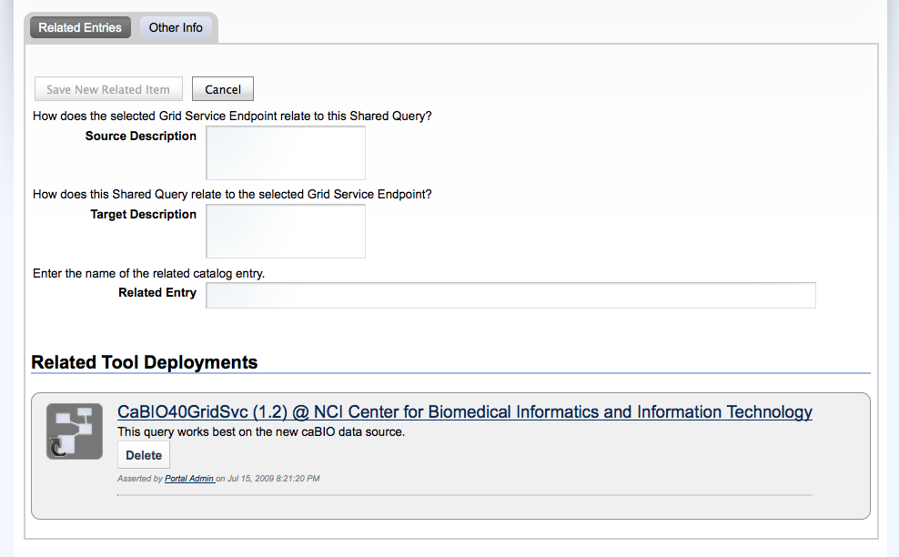
caGrid Portal: Browsing, Searching, Contributing
Search by
Keyword
Share Useful
Queries
Browse by
Category
Ratings,
Comments
Search Live
Data Sources
Links,
Relationships
Notes:
Catalog entries, like data sets and tools, can be tagged with terms from caBIG terminologies. This allows users to more easily find data sets and tools of interest to them. For example, users can select to just see data sets that have been tagged with a Biospecimens Area of Focus. Shared queries allow users to search live data sources without having to be familiar with query languages or various information models. You can rate or comment existing entries or create links between them. For example, you can say that a particular tools provides great visualization of a certain data set.

Slide 36
caGrid Portal: What’s coming?
Search Templates: Shared queries provide simple drop-downs for customizing the search, e.g. selecting lung cancer vs. breast cancer.
Indexed Data Search: Uses high-performance text search engine, to index both metadata and data. Users have option to search indexed data cache as alternative to distributed queries. The indexed data cache is created and maintained by providing users the choice to add results to the cache.
Credential Management: Manage grid credentials within portal
More Community Portlets: CTMS Reporting, Taverna Workflow
Community Spaces: Customizable collaboration space in portal
For more details: Portal poster, Portal demo movie in KC booth

Slide 37
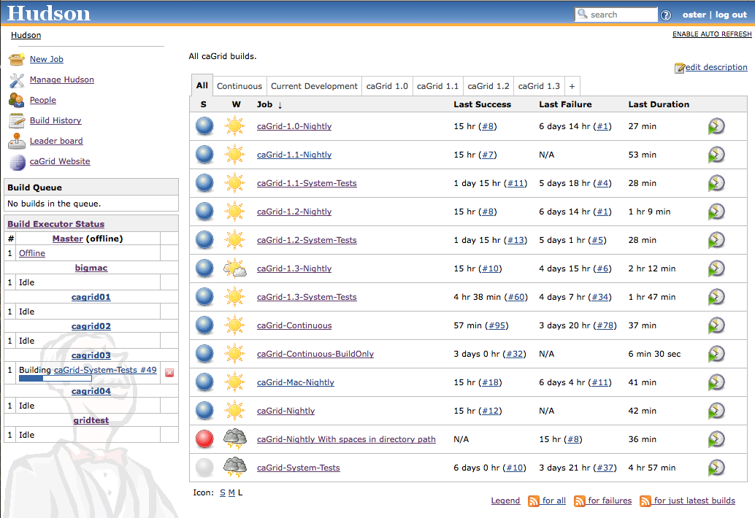
caGrid Quality Dashboard
caGrid automated testing now runs via a Hudson installation with a multi-platform build farm
Replaces previous more custom CruiseControl/DART installation
All historical releases are tested on a nightly basis
Current development continuously built and tested on multiple platforms
619 Unit tests
81 Integration/System tests
Detailed reports accessible via http://quality.cagrid.org/

Slide 38
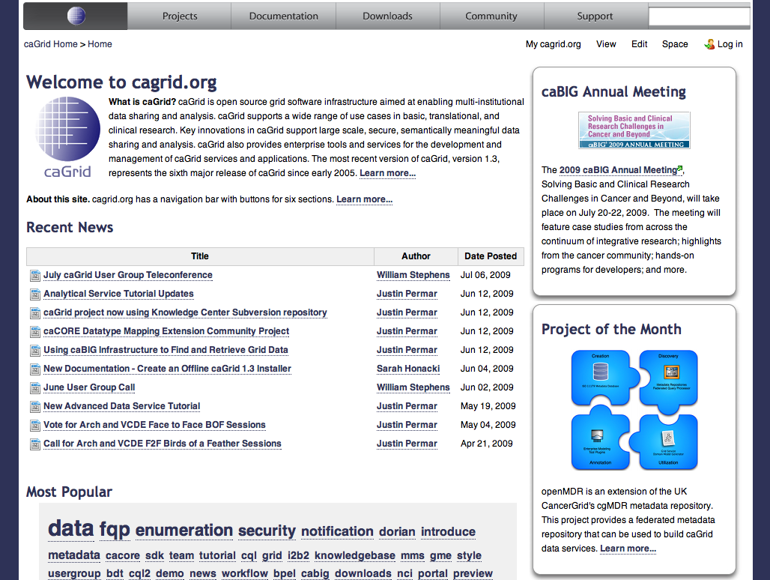
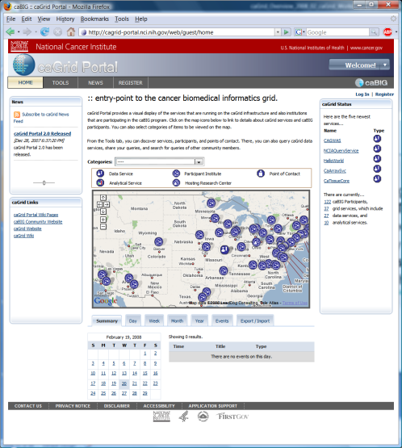
Project Resources and Communication
caGrid Wiki
Download Software
Documentation
Tutorials
Technical Paper and Presentations
FAQs
http://cagrid.org
caGrid Knowledge Center
Knowledge Base
Forums
Enterprise Support
Community engagement
https://cabig-kc.nci.nih.gov/CaGrid/KC/index.php/Main_Page
caGrid GForge Home (project website)
Feature Requests
Bug Reports
Downloads / Source Repository
http://gforge.nci.nih.gov/projects/cagrid-1-0/
caGrid Portal (web portal)
http://cagrid-portal.nci.nih.gov/

Slide 39
Getting Connected to caBIG® and the Grid: caGrid Overview
caBIG 2009 Annual Meeting
Washington, D.C.
July 20th – 22nd, 2009

Slide 40
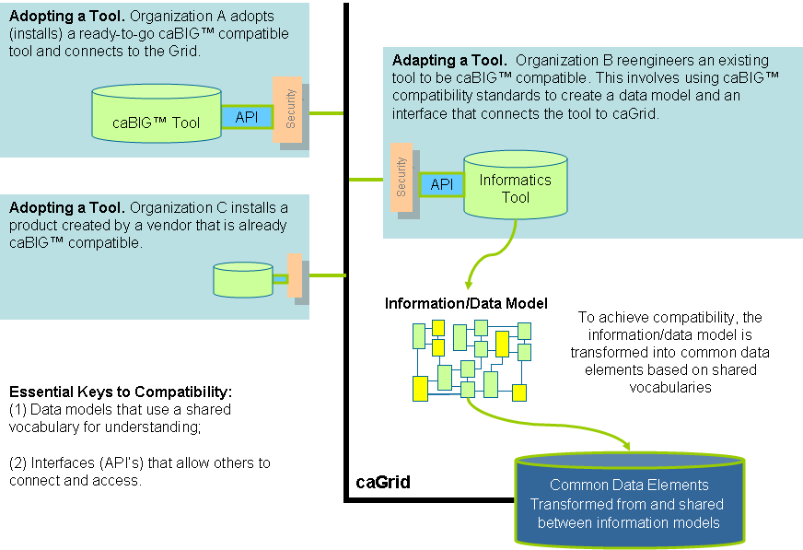
caGrid as the fabric of caBIG

Slide 41
Driving needs: cancer Biomedical Informatics Grid
A multitude of “legacy” information systems, most of which cannot be readily shared between institutions
An absence of tools to connect different databases
An absence of common data formats
A huge and growing volume of data must be collected, analyzed, and made accessible
Few common vocabularies, making it difficult, if not impossible, to interlink diverse research and clinical results
Difficulty in identifying and accessing available resources
An absence of information infrastructure to share data within an institution, or among different institutions

Slide 42
BACKUP SLIDES: caGrid 1.3 Changes

Slide 43
Deprecated Services
During the development of caGrid 1.3, the caGrid Team issued a request for comments on, and adopted, a Deprecation Policy. For details, see: http://cagrid.org/display/caGrid13/Deprecated+Services+and+APIs
After adoption of that policy, the caGrid 1.2 caDSR, caGrid 1.2 EVS, and caGrid 1.2 GME were retired:
caGrid 1.2 caDSR Service (based on caCORE 3.1)
Replaced by the caDSR 4.0 Data Service and the new caGrid 1.3 Metadata Model Service (MMS)
caGrid 1.2 EVS Service (based on caCORE 3.1)
Superseded by EVS 4.1 Grid Service
caGrid 1.2 GME Service
Replaced by new GME service
These retired services will continue to operate until Q2 2009, when the caCORE 3.1 API is decommissioned.
While still supported in caGrid 1.3, the BDT framework is deprecated

Slide 44
Deprecated Services
During the development of caGrid 1.3, the caGrid Team issued a request for comments on, and adopted, a Deprecation Policy. For details, see:http://cagrid.org/display/caGrid13/Deprecated+Services+and+APIs
After adoption of that policy, the caGrid 1.2 caDSR, caGrid 1.2 EVS, and caGrid 1.2 GME were retired:
caGrid 1.2 caDSR Service (based on caCORE 3.1)
Replaced by the caDSR 4.0 Data Service and the new caGrid 1.3 Metadata Model Service (MMS)
caGrid 1.2 EVS Service (based on caCORE 3.1)
Superseded by EVS 4.1 Grid Service
caGrid 1.2 GME Service
Replaced by new GME service
These retired services will continue to operate until Q2 2009, when the caCORE 3.1 API is decommissioned.
While still supported in caGrid 1.3, the BDT framework is deprecated

Slide 45
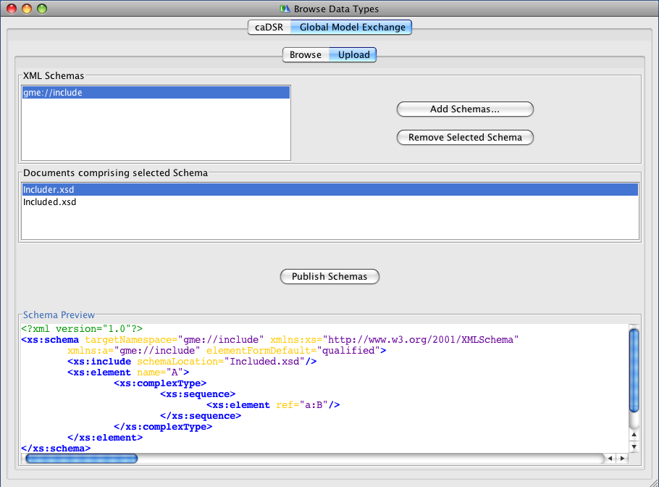
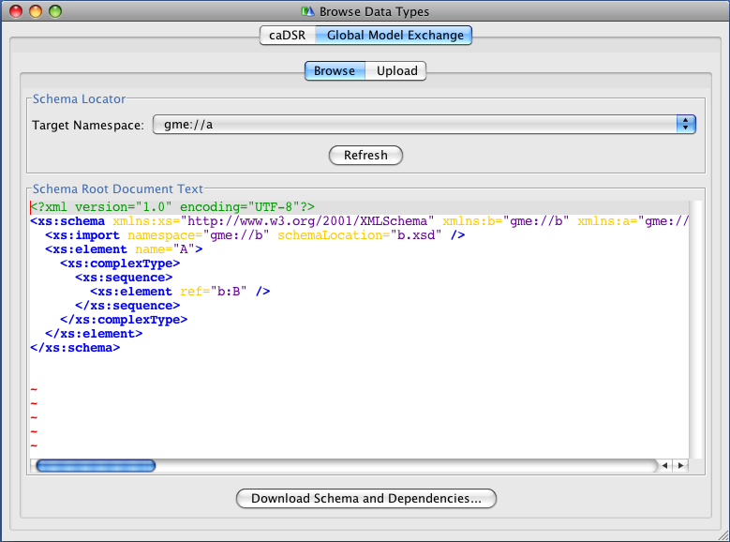
Gold Compatibility: Global Model Exchange (GME)
Completely re-implemented for caGrid 1.3 to address numerous feature requests and limitations
Now a fully managed Introduce service (previously was just a wrapper to the Mobius GME software)
Leverages…
Spring for configuration and data patterns
Hibernate for data persistence
Castor for custom domain model serialization
Xerces for 100% XML Schema support
Improved Introduce integration
Selected new features:
Now supports XML Schemas with includes, redefines, cyclic imports, arbitrary namespaces
Schema Deletion
MySQL 5 support

Slide 46
Gold Compatibility: Metadata Model Service (MMS)
As the caDSR Grid service was retired, its functionality was replaced with the caDSR Data Service and the new MMS
MMS provides the metadata-oriented functionality, such as generating Domain Models and semantically annotating Service Metadata
Simple migration path from caDSR grid service to MMS
Is a generic service which provides the ability to integrate any external metadata registry as a metadata source for annotations
Leverages Spring for deploy-time configuration
Default implementation uses the production caDSR as its source, but (multiple) other registries can be added to the same service
Not dependent on a particular model or software version of the caDSR
Makes full use of the new caDSR XML Schema namespace binding annotations
Fully integrated into Introduce for visualizing Domain Models and annotating metadata instances

Slide 47
Gold Compatibility: Index Service
Working with the Globus MDS team (ISI), the Index Service implementation was completely redesigned for better memory usage and performance
Leverages Apache Xindice XML Database for “out of memory” storage and query (previous version was all Heap-based).
Added multi-threading for metadata polling to greatly increase registration throughput
Slight change in behavior, but 100% backwards compatible to Discovery and Advertisement clients
Production Index Service now running smoothly with 130+ registrations
Local tests scaled up into the thousands
Modified default Introduce-generated advertisement settings to reduce the load on the Index Service while maintaining the same response time

Slide 48

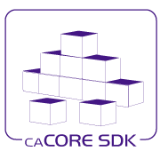
caCORE SDK Integration
Created Data Service Introduce extension for SDK 4.1.1
Upgraded Introduce XMI-based schema generation to leverage SDK 4.1.1
Shared libraries between SDK and caGrid:
Common CQL Processor for SDK and Data Services
Common Testing of caGrid and SDK

Slide 49
Data Services: Federated Query Processor (FQP)
Added configurable query execution parameters to allow control over behavior in the face of failure
Ability to return partial results, specify retries, or fail
Added new results metadata which gets updated during query execution containing:
Overall processing status (waiting, working, done, etc)
Details of each target service (range of data in results, faults, etc)
Support WS-Notification
Client can be notified of changes in execution status for example
Support for delegation via integration with Credential Delegation Service (CDS)
Client can use CDS to delegate to FQP, and request FQP to query data services using the delegated credential
Support for using caGrid Transfer to obtain query results
Performance enhancements, included multi-threaded queries

Slide 50
Introduce Toolkit: Security-related improvements
Created authorization extension framework for plugging in arbitrary authorization components
Migrated Grid Grouper and CSM Authorization to authorization extensions
Created an authorization extension to do “authentication only” (i.e. check that the user presented a credential)
Greater ability for client to control use of credentials
Clients now have a preferAnonymous operation which can be used to override service suggestions
Greater clarity of effect of options in GUI for security settings
Integrated GAARDS UI components to Introduce (e.g. ability to login, request credentials, etc)

Slide 51
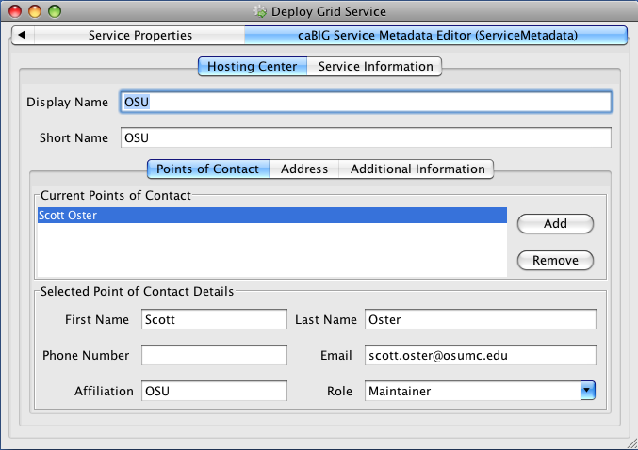
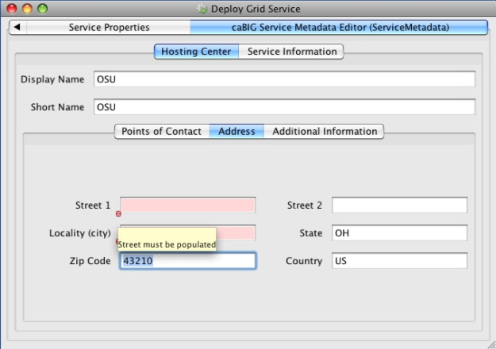
Introduce Toolkit: Other improvements
Added deploy-time validation extension framework
caGrid metadata validator ensures proper metadata is filled out or prevents deployment (e.g. point of contact, host information)
Developed Service Upgrade Support for previous versions
1.1 -> 1.3
1.2 -> 1.3
No Updater for 1.0 -> 1.3

Slide 52
Security: Authentication Enhancements
Addition of Authentication Profiles, adding support for authentication beyond just “username/password”
Support for one-time passwords profile included in this release
Authentication Service refactored to support; Dorian added implementation
Ability to securely discover Trusted Identity Providers
Dorian now maintains authentication service metadata (URL and identity) for its IDPs
Clients can discover Authentication Services for trusted IDPs by asking Dorian or viewing its new metadata exposing this information
GAARDS UI now leverages this

Slide 53
Security: WebSSO Enhancements
Created an Acegi client
Out of the box support for Liferay
Updated to newer CAS versions (server:3.2.2, client:3.1.1)
Implementation of Single Sign-Out
A user logging off of one application will be logged off of all participating in the SSO session
Added support for Authentication Profiles and discovery of Authentication Services via Dorian’s trusted IDP metadata
Created comprehensive integration tests which deploy and test the WebSSO server, sample applications, Dorian, and CDS

Slide 54
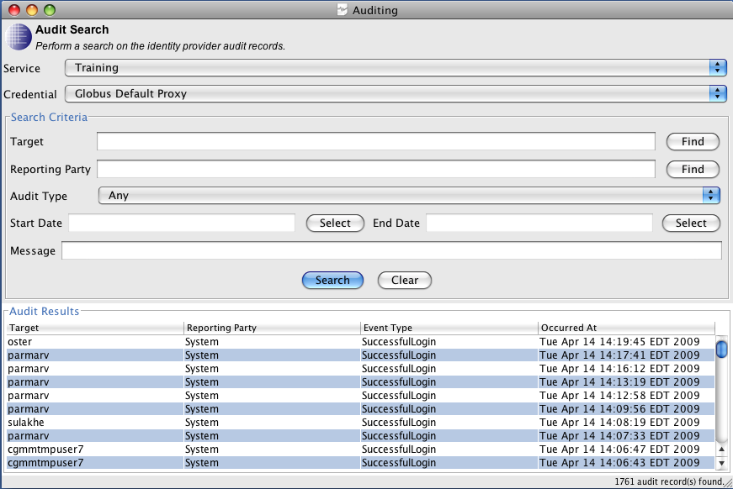
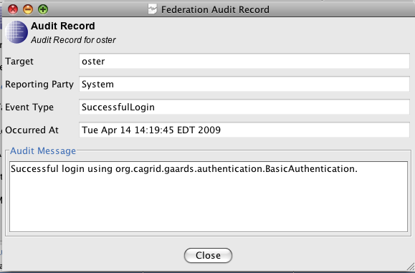
Security: Dorian
Service now leverages Spring for configuration
Implementation of Authentication Profiles and IDP metadata
Move from issuing Proxy Certificates to Short-Term Certificates
Added comprehensive auditing to service and ability to access audit records over the service interface (as an admin)
GAARDS UI support for querying and viewing audit records

Slide 55
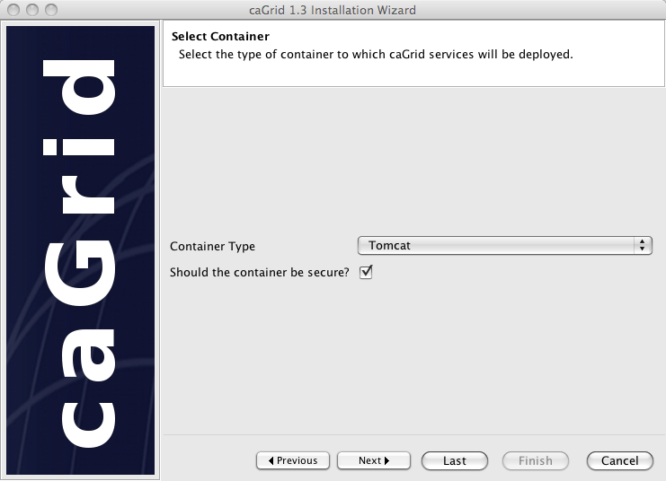
caGrid 1.3 Installer
Refactored and refocused on desktop deployment (most common pattern)
Does not deploy/configure services anymore
Installs: prerequisites, configures caGrid, and configures containers (current CBIIT technology stack)
Added support for Jboss
Can launch GAARDS UI to request credentials directly during installation
No longer necessary to stop and start installation for secure container configuration
Can easily be used to retarget a container to a new grid (change target grids and install new credentials)
Better support for custom target grids
Other usability improvements such as avoiding re-downloading, setting execute permissions on scripts, minimizing steps, etc

Slide 56
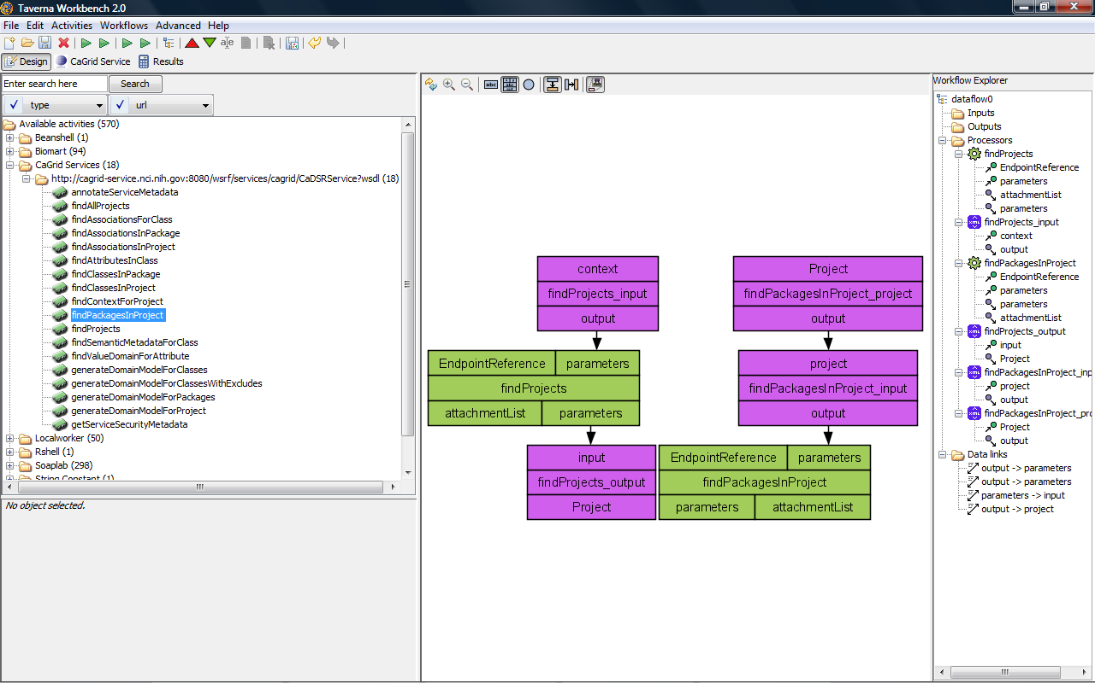
Workflow: Taverna
Added a new service Taverna Workflow Factory Service for executing Scufl (Simple Conceptual Unified Flow language) workflows, which is the language of the Taverna Workbench
Leverages the same service infrastructure as the existing BPEL-based workflow service
Updated client support to Taverna 2

